Slide 1
WELCOME
Jim Ridgway
CAIP Sub-fund Administrator
NJSIG
Vice President
J. Byrne Agency
CAIP
In-Person Meeting
Practical Review of Federal Education Policy Changes
& How to Calculate Salary After an Increment Withholding
& NJ Assembly Update on Schools
Tuesday, May 6, 2025

Slide 2
WELCOME
Jim Ridgway
CAIP Sub-fund Administrator
NJSIG
Vice President
J. Byrne Agency
CAIP
In-Person Meeting
Practical Review of Federal Education Policy Changes
& How to Calculate Salary After an Increment Withholding
& NJ Assembly Update on Schools
Tuesday, May 6, 2025
NJSIG UPDATE
Joe Semptimphelter
Senior Business Development Specialist
jsemptimphelter@njsig.org
609-386-6060 x3044

Slide 3
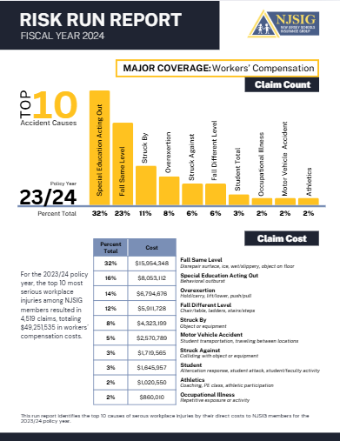
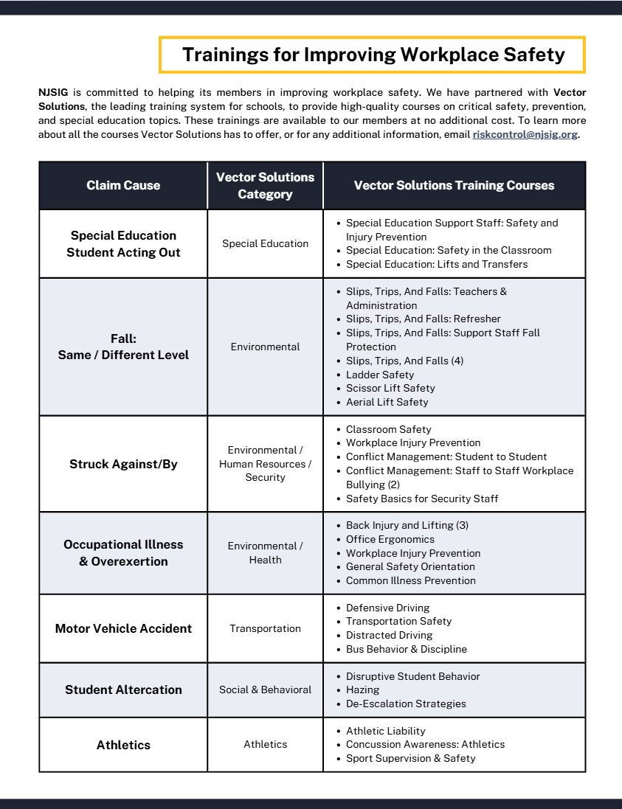
WELCOME
Jim Ridgway
CAIP Sub-fund Administrator
NJSIG
Vice President
J. Byrne Agency
NJSIG EXECUTIVE UPDATE
NJSIG UPDATE
Joe Semptimphelter
Senior Business Development Specialist
jsemptimphelter@njsig.org
609-386-6060 x3044
RISK RUN REPORT

Slide 4
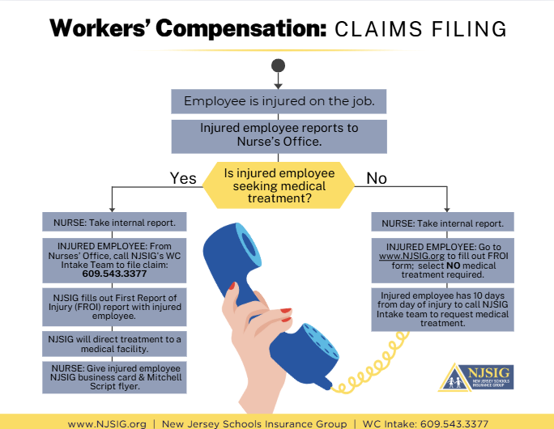
NJSIG UPDATE
Joe Semptimphelter
Senior Business Development Specialist
jsemptimphelter@njsig.org
609-386-6060 x3044
NJSIG EXECUTIVE UPDATE
RISK RUN REPORT
RECENT INTAKE TRAINING

Slide 5
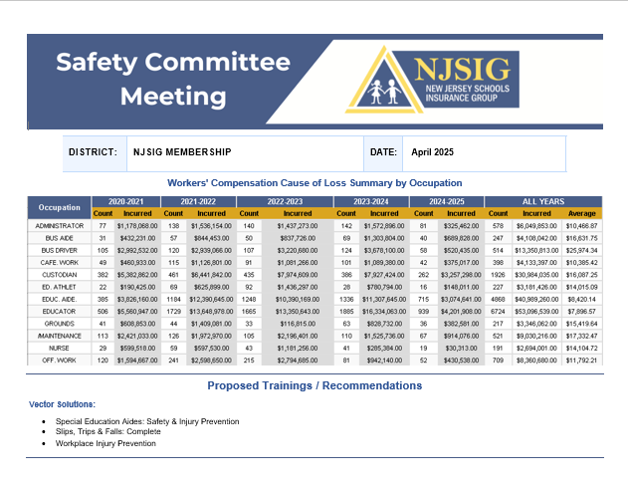
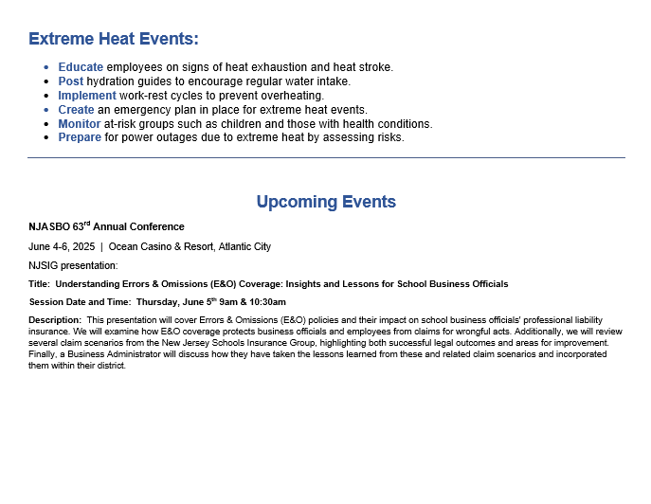
SUB-FUND ADMINISTRATOR REPORT
RISK RUN REPORT
NJSIG EXECUTIVE UPDATE
RECENT INTAKE TRAINING
SAFETY FLYER

Slide 6
SUB-FUND ADMINISTRATOR REPORT
RECENT INTAKE TRAINING
NJSIG EXECUTIVE UPDATE
SAFETY FLYER
PRESENTATION
Practical Review of Federal Education Policy Changes
& How to Calculate Salary After an Increment Withholding
Presenter:
Brett Gorman
Gorman, D’Anella & Morlok

Slide 7
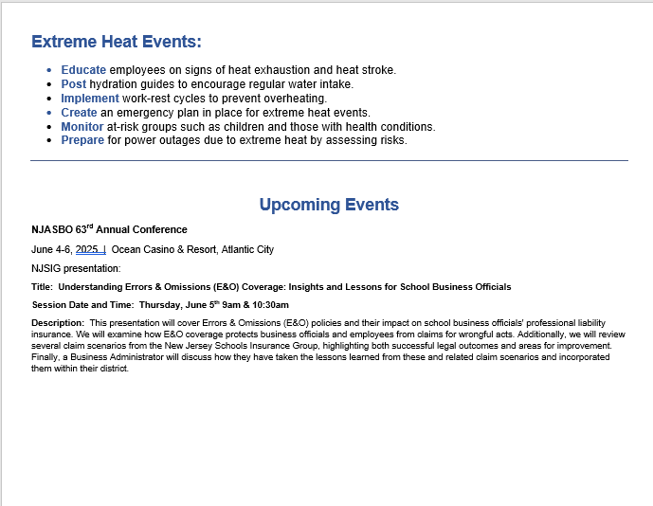
SAFETY FLYER
Latonya Brennan | Dan Regan | Barbara Fitzpatrick
Amanda DeNapoli | Eva Jakowluk
NJSIG EXECUTIVE UPDATE
PRESENTATION
Practical Review of Federal Education Policy Changes
& How to Calculate Salary After an Increment Withholding
Presenter:
Brett Gorman
Gorman, D’Anella & Morlok

Slide 8
SAFETY FLYER
Latonya Brennan | Dan Regan | Barbara Fitzpatrick
Amanda DeNapoli | Eva Jakowluk
NJSIG EXECUTIVE UPDATE
PRESENTATION
NJ Assembly Update on Schools
Presenter:
Assemblyman Erik Simonsen
District 1
Member of Assembly Education Committee
& Joint Committee on Public Schools in New Jersey

Slide 9
THANK YOU!

